Slide 1

SecureChat: Zero Trust Cybersecurity Chatbot
Welcome to our presentation on SecureChat, the zero-trust cybersecurity chatbot. Built with Flask and MongoDB, it ensures private, secured communication.
Presented By:
Saad Ahmad Malik 2022-CS-1
Waleed Ahmad 2022-CS-41

Slide 2

Project Overview
Objective
Value
Create a secure, private communication platform preventing data breaches and unauthorized access.
Enhanced security, user control, and data privacy tailored for businesses and individuals.
Target Users
Designed for organizations, enterprises, and users needing trusted chat solutions.

Slide 3
Technical Architecture
Frontend
Backend
Database
Deployment
HTML, CSS, JavaScript with animated transitions for smooth UX.
Flask (Python) serving REST API for secure communication.
MongoDB NoSQL for scalable and flexible data storage.
Hosted on Render platform for reliable, cloud-based access.

Slide 4





System Diagram
User Interaction
Users send requests through the frontend interface.
API Gateway
Routes requests to the authentication and message services securely.
Authentication Service
Verifies user identity before granting access.
Database
Stores encrypted user data and manages chat histories.

Slide 5

Zero Trust Architecture (ZTA)
Never Trust, Always Verify
Every access requires continuous authentication and validation.
Identity-Centric
Security focuses on user identity for all requests.
Microsegmentation
Limits the scope of breaches to minimize impact.
Continuous Monitoring
Real-time tracking of events to detect threats swiftly.

Slide 6
Security Features: Authentication
Multi-Factor Authentication
Role-Based Access Control
AES Encryption
RSA Encryption
Protects chat history with strong symmetric encryption.
Secures user data during storage and transmission using asymmetric keys.
OTP via SMS or email secures login and access.
Users have permissions based on assigned roles for better security.

Slide 7
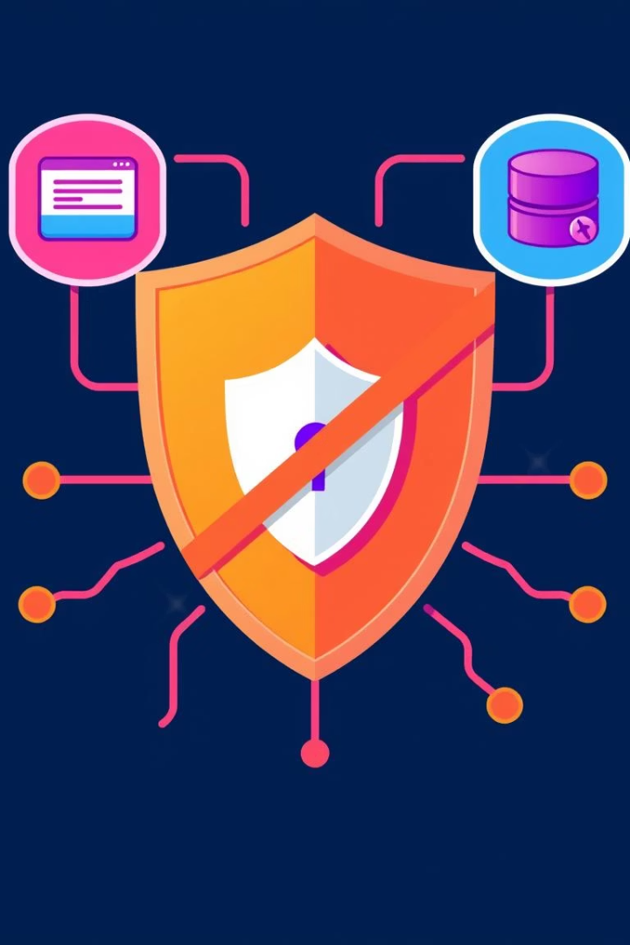
Security Features: Threat Mitigation
XSS Prevention
Sanitizes inputs to block script injection attacks.
NoSQL Injection Prevention
Validates queries to prevent unauthorized database access.
Penetration Testing
Regular security audits identify and fix vulnerabilities.
Real-Time Monitoring
Detects and responds to threats as they occur.

Slide 8
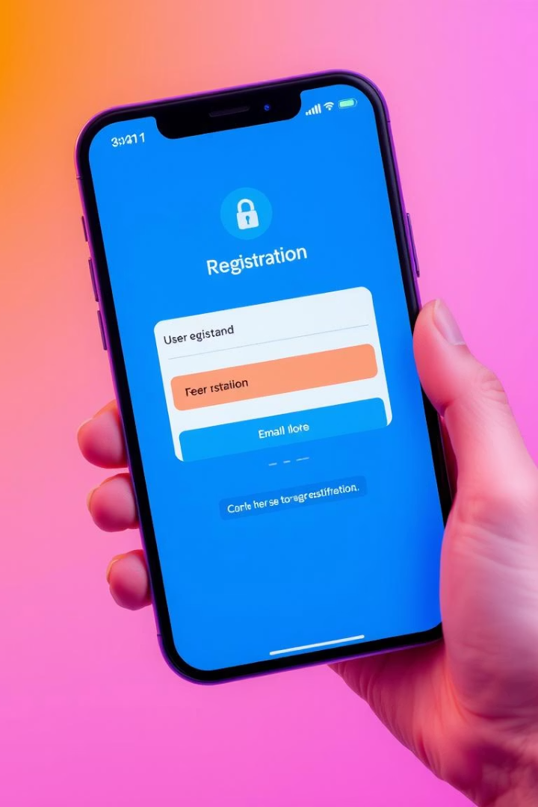




Project Features: User Registration
Secure Registration
Email Verification
Password Policies
Ensures validity of account through confirmation emails.
Strong password rules prevent weak credentials.
Robust process for new users to join safely.
Profile Management
Users can customize settings securely at any time.

Slide 9
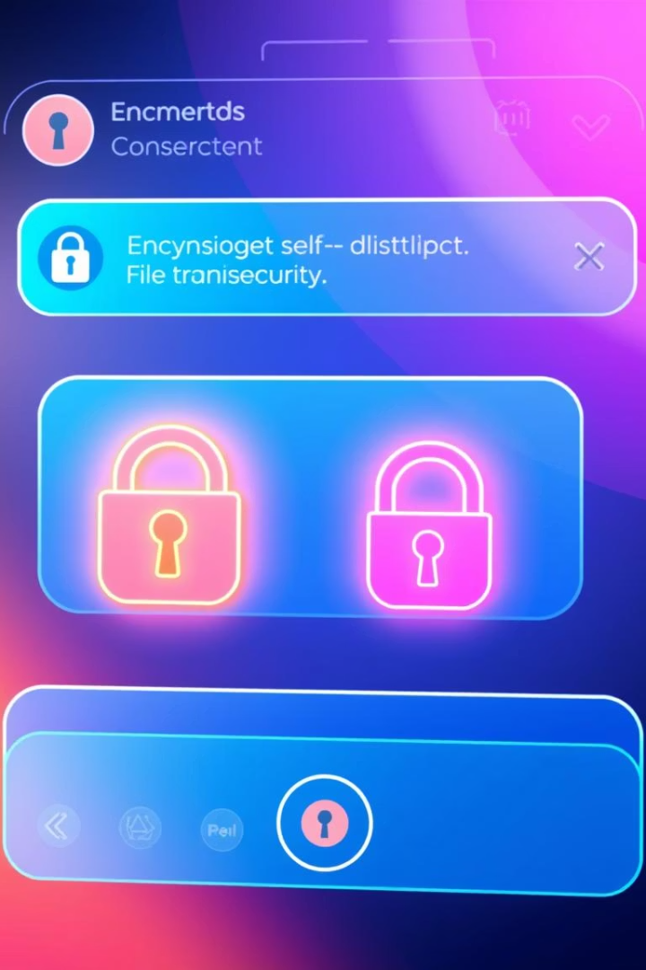
Project Features: Secure Chat
End-to-End Encryption
Messages protected with AES for confidentiality.
Message Expiration
Options to auto-delete messages enhance privacy.
Secure File Transfer
Transmits files safely within chats without leaks.
Audit Logs
Track activity for security and compliance purposes.

Slide 10

Conclusion: The Future of Secure Communication
Robust Zero Trust Solution
Scalable and User-Friendly
Future Roadmap
Integrate AI-driven threat detection and dynamic response.
SecureChat protects sensitive data with cutting-edge security.
Easy deployment and intuitive interface for broad adoption.

